Slide 1
Brief introduction
Raindrop Collision Simulation
Lihui Ji
July 18, 2021

Slide 2
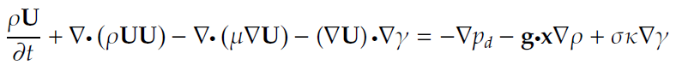
Ultimate Goal: Simulate raindrop interactions (collision & breakup) in natural environment.
The process:
One Raindrop Free Fall → Two Raindrops Collision → Multi Raindrops Interactions
Governing Equation (Navier Stokes Equation + Volume of Fluid Method):
Simulation Method: Finite Volume Method
Solver: The modified interFoam solver (OpenFOAM program). After each timestep, all simulated properties are moved such that the water drop is always in the domain center.
Problem: Need better computation power for 3D case

Slide 3
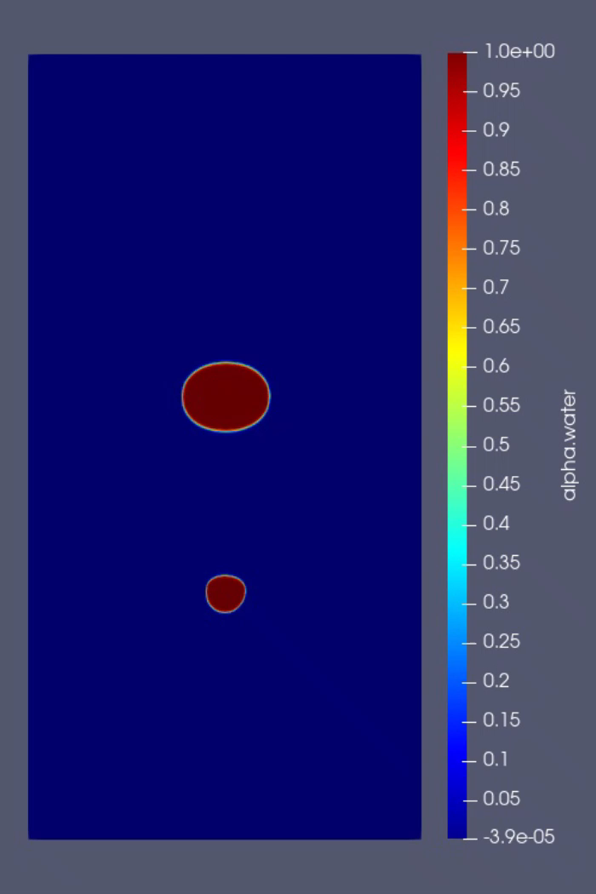
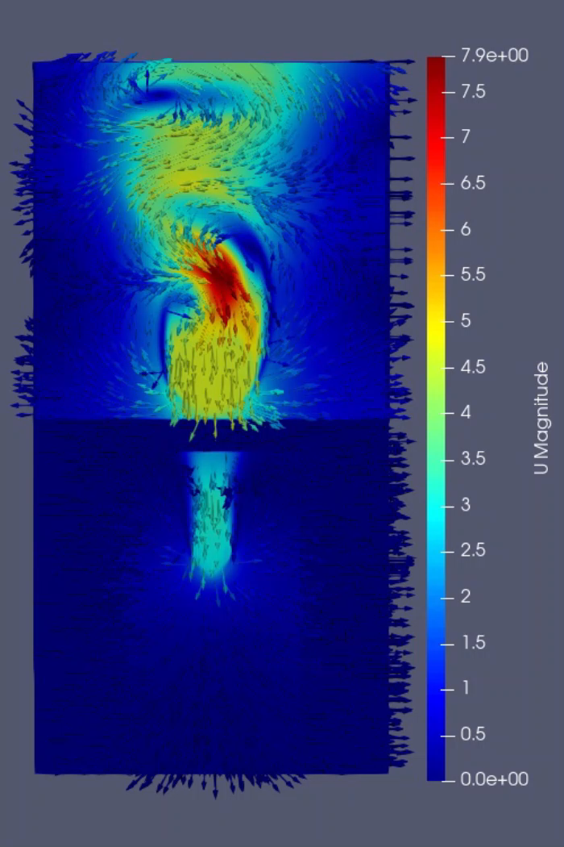
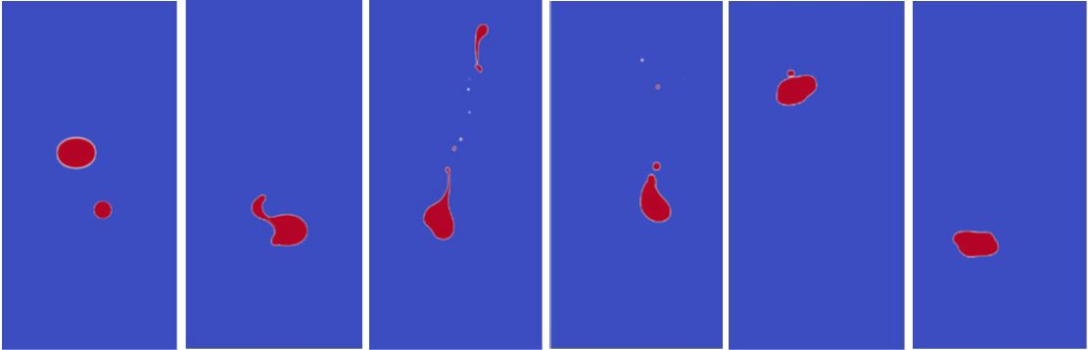
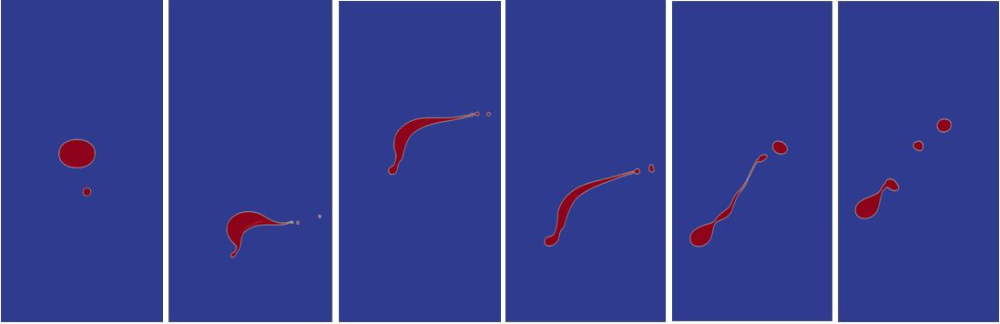
Collision cases
Neck (Filament) Breakup
Disk Breakup

Slide 4
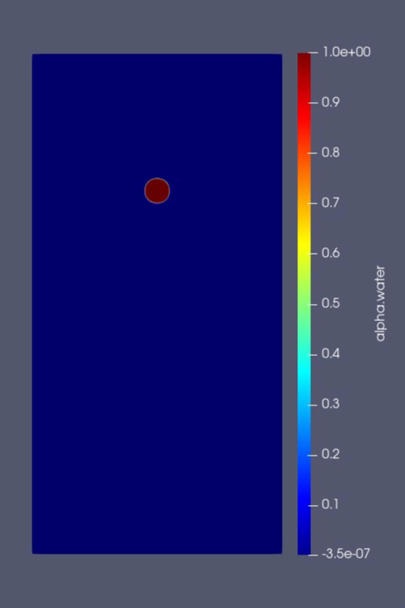
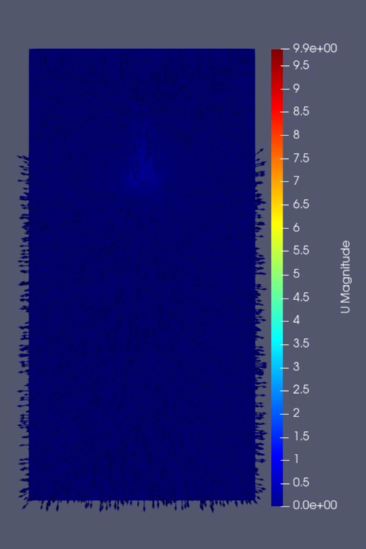
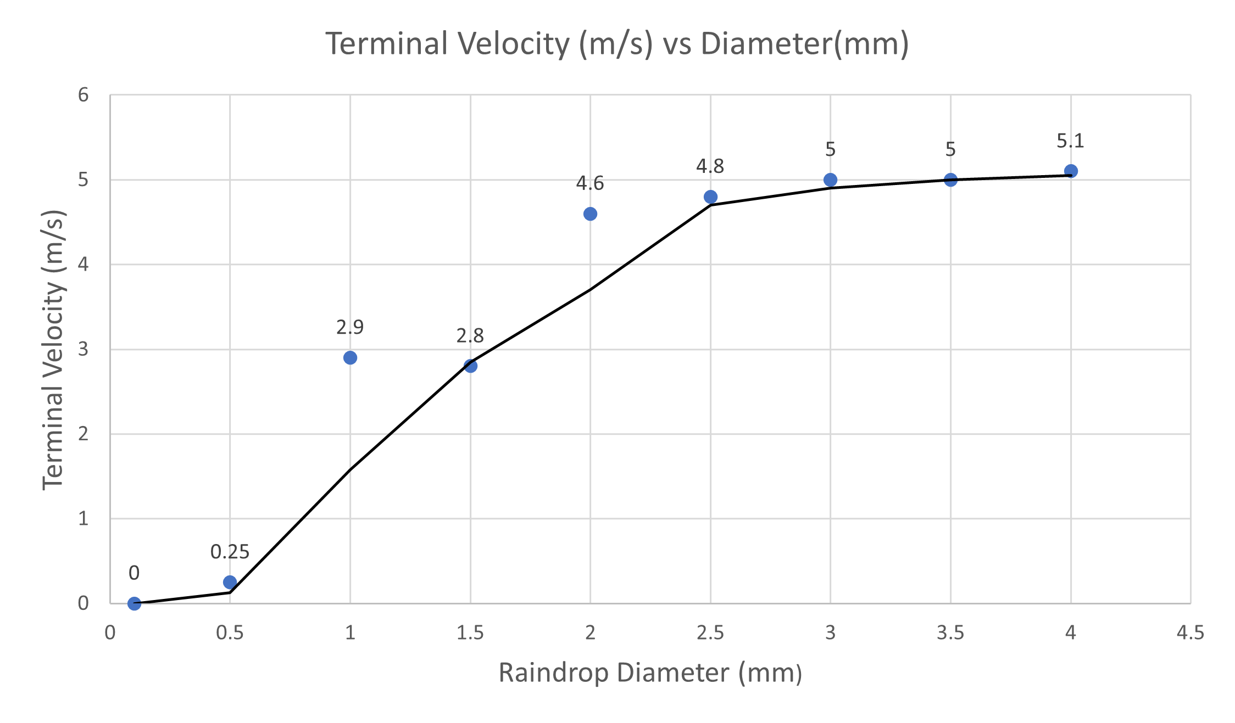
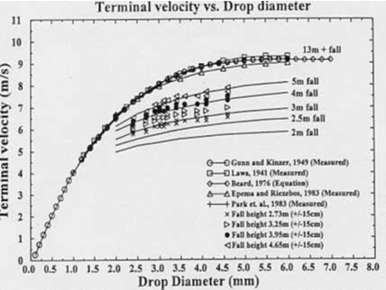
Raindrop free falling (Need 3D simulation)
Simulation Result
Field Measurement

